Slide 1

Introduction to Logistic Regression In Stata
Maria T. Kaylen, Ph.D.
Indiana Statistical Consulting Center
WIM Spring 2014
April 11, 2014, 3:00-4:30pm

Slide 2
The Data/Research Question
Logistic regression is used when the dependent variable is binary.
  Typical coding:
  0 for negative outcome (event did not occur)
  1 for positive outcome (event did occur)
Use this when you are interested in seeing how the independent variables affect the probability of the event occurring (or not occurring).

Slide 3
Examples
What demographic factors are related to whether or not someone votes in an election?
What circumstances affect the likelihood of someone being found guilty of a crime?
Do standardized test scores, high school grades, and social factors affect whether or not someone graduates from college?

Slide 4
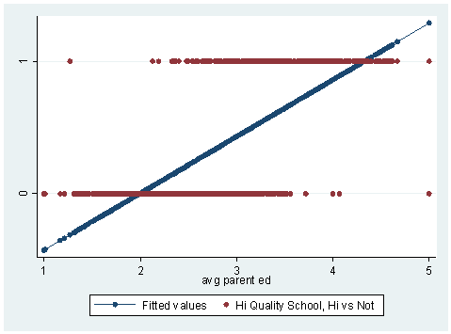
Why Not Fit a Linear Model?
Example from UCLA’s Institute for Digital Research and Education website
Data: 1200 CA high schools, measuring achievement
DV: hiqual (high quality school or not, 0/1)
IV: avg_ed (average education of parents, 1-5)
Blue, “fitted values” are the predicted values from an OLS model
Red values are observed in the data
Problems: Negative values, values between 0 and 1

Slide 5
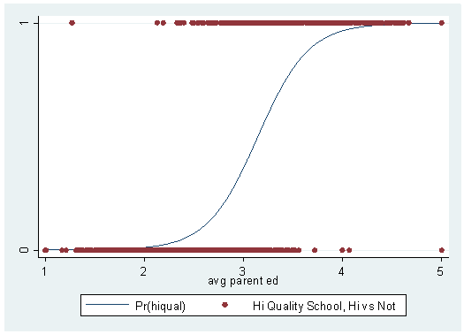
A Better Model
Blue line is the probability of hiqual=1 from the logistic regression model
Red values are observed in the data
Data fit is vastly improved
Predicted probabilities between 0 and 1
Fits the observed data better

Slide 6
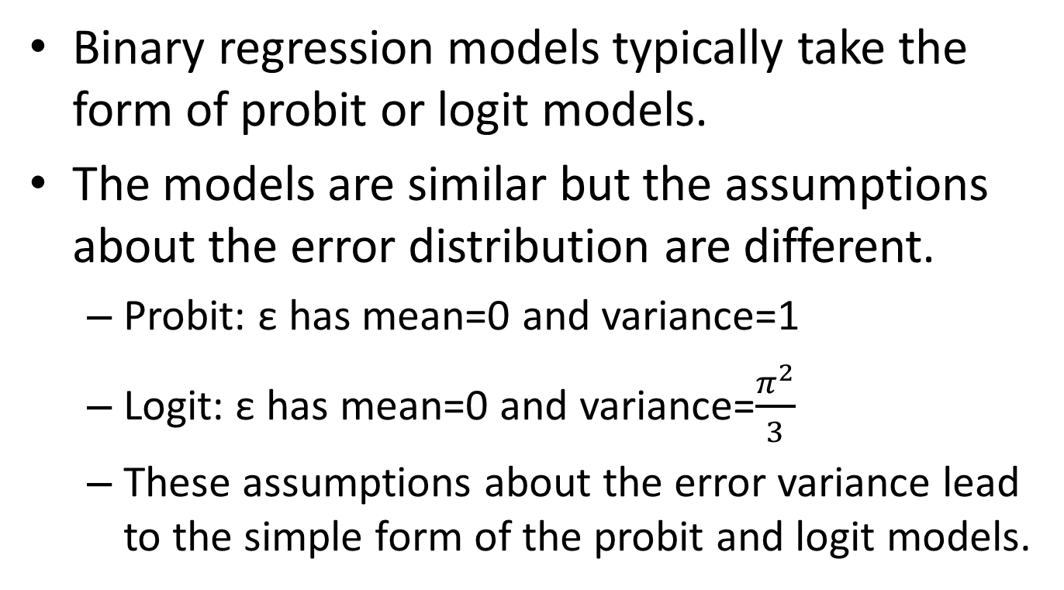
What is logistic regression?
Binary regression models typically take the form of probit or logit models.
The models are similar but the assumptions about the error distribution are different.
  Probit: ε has mean=0 and variance=1
  Logit: ε has mean=0 and variance=$\frac{π^{2}}{3}$
  These assumptions about the error variance lead to the simple form of the probit and logit models.

Slide 7
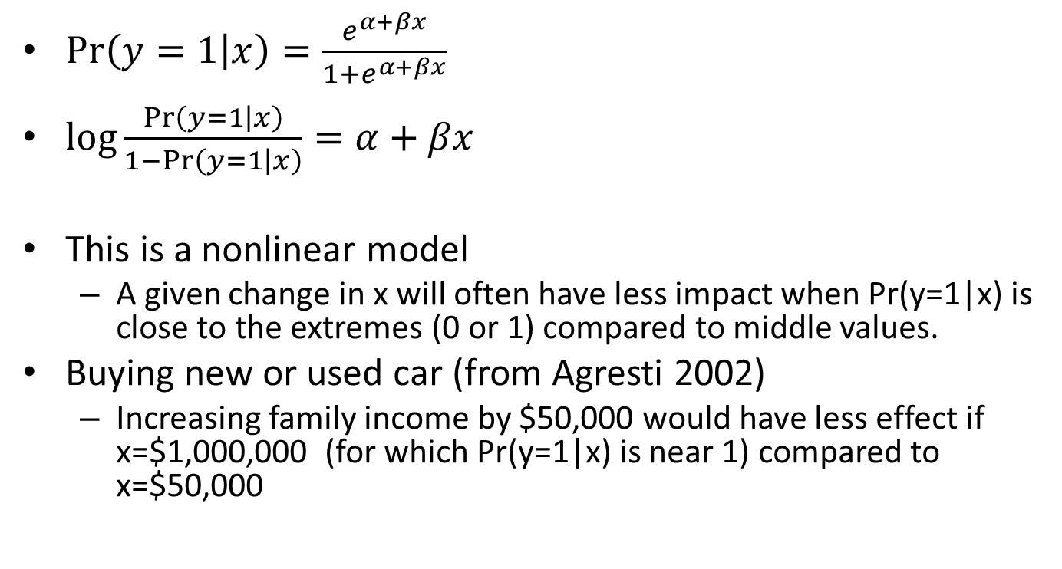
Logistic Regression Model
$\operatorname{Pr}\left(y=1 | x\right)=\frac{e^{α+βx}⁡}{1+e^{α+βx}⁡}$
$\log{\frac{\operatorname{Pr}\left(y=1 | x\right)}{1−\operatorname{Pr}\left(y=1 | x\right)}}=α+βx$
This is a nonlinear model
  A given change in x will often have less impact when Pr(y=1|x) is close to the extremes (0 or 1) compared to middle values.
Buying new or used car (from Agresti 2002)
  Increasing family income by $50,000 would have less effect if x=$1,000,000 (for which Pr(y=1|x) is near 1) compared to x=$50,000

Slide 8
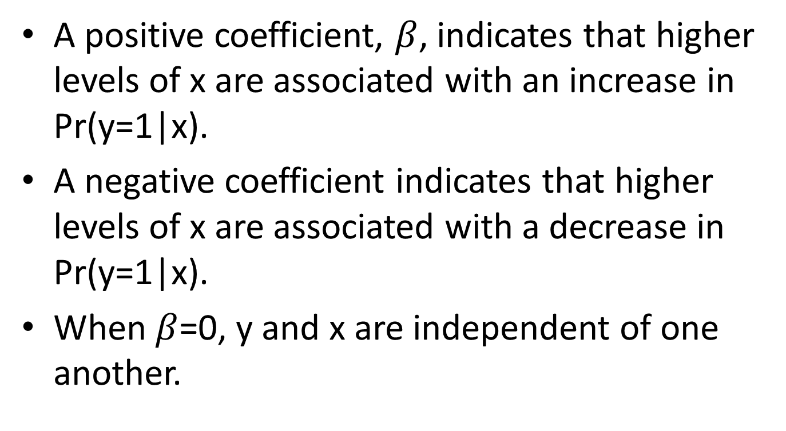
Interpreting Coefficients
A positive coefficient, $β$, indicates that higher levels of x are associated with an increase in Pr(y=1|x).
A negative coefficient indicates that higher levels of x are associated with a decrease in Pr(y=1|x).
When $β$=0, y and x are independent of one another.

Slide 9
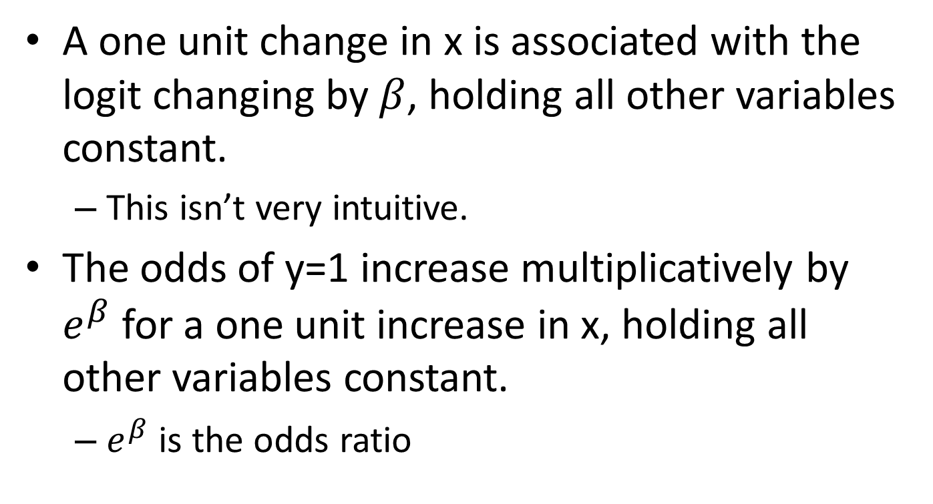
Interpreting Coefficients
A one unit change in x is associated with the logit changing by $β$, holding all other variables constant.
  This isn’t very intuitive.
The odds of y=1 increase multiplicatively by $e^{β}$ for a one unit increase in x, holding all other variables constant.
  $e^{β}$ is the odds ratio

Slide 10
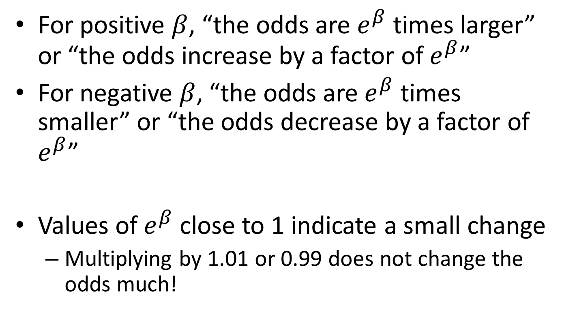
Interpreting Coefficients
For positive $β$, “the odds are $e^{β}$ times larger” or “the odds increase by a factor of $e^{β}$”
For negative $β$, “the odds are $e^{β}$ times smaller” or “the odds decrease by a factor of $e^{β}$”
Values of $e^{β}$ close to 1 indicate a small change
  Multiplying by 1.01 or 0.99 does not change the odds much!

Slide 11
Logit Command in Stata
Logit dep_var ind_vars
Note 1: If you select a dependent variable that isn’t already coded as binary, Stata will define var=0 as 0 and all other values as 1.
Note 2: Stata uses listwise deletion meaning that if a case has a missing value for any variable in the model, the case will be removed from the analysis.

Slide 12
Logit Output
. logit ER stranger age i.income
Iteration 0: log likelihood = -2227.7515
Iteration 1: log likelihood = -2192.8024
Iteration 2: log likelihood = -2192.1977
Iteration 3: log likelihood = -2192.1975
Logistic regression Number of obs = 5503
LR chi2(5) = 71.11
Prob > chi2 = 0.0000
Log likelihood = -2192.1975 Pseudo R2 = 0.0160
--------------------------------------------------------------------------------
ER | Coef. Std. Err. z P>|z| [95% Conf. Interval]
---------------+----------------------------------------------------------------
stranger | .3383692 .0833018 4.06 0.000 .1751007 .5016377
age | .0149814 .0026882 5.57 0.000 .0097127 .0202501
|
income |
Low Income | -.188747 .0916493 -2.06 0.039 -.3683764 -.0091176
Middle Income | -.4270387 .1274591 -3.35 0.001 -.6768539 -.1772235
High Income | -.5189086 .1362384 -3.81 0.000 -.7859309 -.2518862
|
_cons | -2.20777 .1039755 -21.23 0.000 -2.411558 -2.003982
--------------------------------------------------------------------------------

Slide 13
SPost
J. Scott Long and Jeremy Freese wrote a program, SPost, that helps with interpreting results of categorical data analysis in Stata.
To install it,
findit spostado

Slide 14
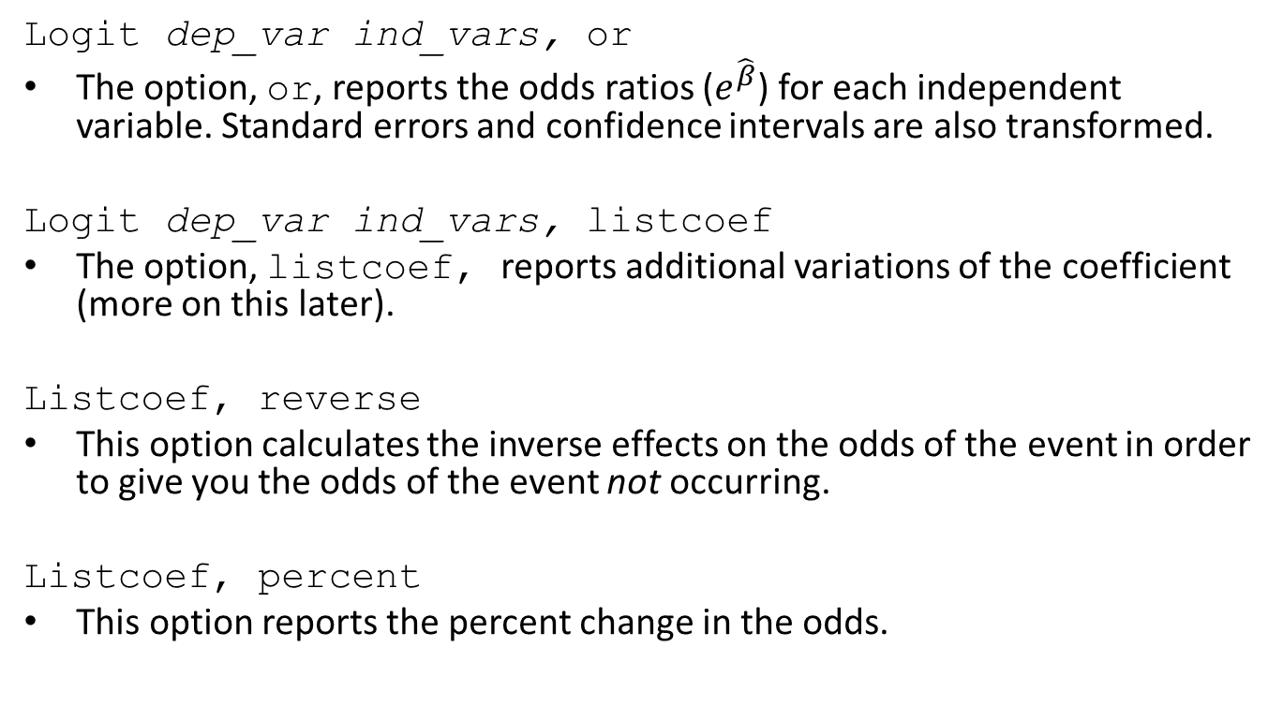
Logit Command
Logit dep_var ind_vars, or
The option, or, reports the odds ratios ($e^{\hat{β}}$) for each independent variable. Standard errors and confidence intervals are also transformed.
Logit dep_var ind_vars, listcoef
The option, listcoef, reports additional variations of the coefficient (more on this later).
Listcoef, reverse
This option calculates the inverse effects on the odds of the event in order to give you the odds of the event not occurring.
Listcoef, percent
This option reports the percent change in the odds.

Slide 15
Logit, OR Output
. xi: svy: logit ER stranger age i.income, or
i.income _Iincome_1-4 (naturally coded; _Iincome_1 omitted)
(running logit on estimation sample)
Survey: Logistic regression
Number of strata = 161 Number of obs = 5503
Number of PSUs = 314 Population size = 17385599
Design df = 153
F( 5, 149) = 12.00
Prob > F = 0.0000
------------------------------------------------------------------------------
| Linearized
ER | Odds Ratio Std. Err. t P>|t| [95% Conf. Interval]
-------------+----------------------------------------------------------------
stranger | 1.343712 .1229243 3.23 0.002 1.121544 1.609889
age | 1.016358 .0026884 6.13 0.000 1.011061 1.021683
_Iincome_2 | .8592334 .0878709 -1.48 0.140 .7020493 1.05161
_Iincome_3 | .6947794 .1043255 -2.43 0.016 .5164337 .9347152
_Iincome_4 | .6243798 .0879345 -3.34 0.001 .4727311 .8246763
_cons | .1068197 .0112196 -21.29 0.000 .0868029 .1314525
------------------------------------------------------------------------------
Note: strata with single sampling unit centered at overall mean.

Slide 16
Logit, OR Output
------------------------------------------------------------------------------
| Linearized
ER | Odds Ratio Std. Err. t P>|t| [95% Conf. Interval]
-------------+----------------------------------------------------------------
stranger | 1.343712 .1229243 3.23 0.002 1.121544 1.609889
age | 1.016358 .0026884 6.13 0.000 1.011061 1.021683
_Iincome_2 | .8592334 .0878709 -1.48 0.140 .7020493 1.05161
_Iincome_3 | .6947794 .1043255 -2.43 0.016 .5164337 .9347152
_Iincome_4 | .6243798 .0879345 -3.34 0.001 .4727311 .8246763
_cons | .1068197 .0112196 -21.29 0.000 .0868029 .1314525
------------------------------------------------------------------------------
Note: strata with single sampling unit centered at overall mean.
The odds of victims going to the ER increase by a factor of 1.34 when the offender is a stranger compared to a non-stranger, holding other variables constant (p<.01).
The odds of victims going to the ER increase by a factor of 1.02 for a one year increase in age, holding other variables constant (p<.01).
The odds of victims going to the ER decrease by a factor of 0.69 for middle income victims compared to lowest income victims, holding other variables constant (p<.05).

Slide 17
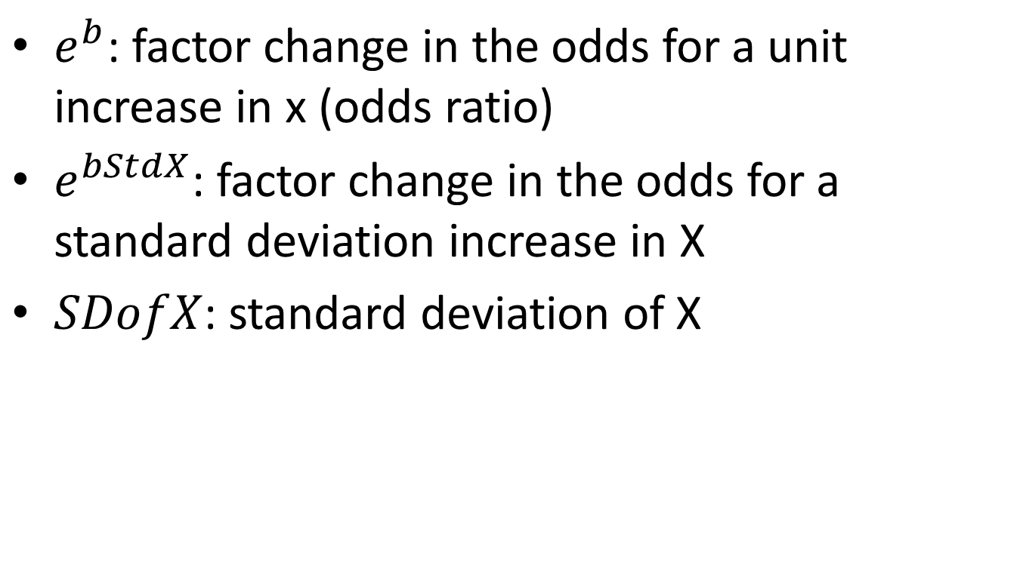
Listcoef
$e^{b}$: factor change in the odds for a unit increase in x (odds ratio)
$e^{bStdX}$: factor change in the odds for a standard deviation increase in X
$SDofX$: standard deviation of X

Slide 18
Listcoef Output
. listcoef, help
logit (N=5503): Factor Change in Odds
Odds of: ER vs No_ER
----------------------------------------------------------------------
ER | b z P>|z| e^b e^bStdX SDofX
-------------+--------------------------------------------------------
stranger | 0.29544 3.229 0.001 1.3437 1.1437 0.4544
age | 0.01623 6.134 0.000 1.0164 1.2408 13.2954
_Iincome_2 | -0.15171 -1.484 0.138 0.8592 0.9329 0.4580
_Iincome_3 | -0.36416 -2.425 0.015 0.6948 0.8812 0.3472
_Iincome_4 | -0.47100 -3.344 0.001 0.6244 0.8557 0.3308
----------------------------------------------------------------------
b = raw coefficient
z = z-score for test of b=0
P>|z| = p-value for z-test
e^b = exp(b) = factor change in odds for unit increase in X
e^bStdX = exp(b*SD of X) = change in odds for SD increase in X
SDofX = standard deviation of X

Slide 19
Listcoef Output
----------------------------------------------------------------------
ER | b z P>|z| e^b e^bStdX SDofX
-------------+--------------------------------------------------------
stranger | 0.29544 3.229 0.001 1.3437 1.1437 0.4544
age | 0.01623 6.134 0.000 1.0164 1.2408 13.2954
_Iincome_2 | -0.15171 -1.484 0.138 0.8592 0.9329 0.4580
_Iincome_3 | -0.36416 -2.425 0.015 0.6948 0.8812 0.3472
_Iincome_4 | -0.47100 -3.344 0.001 0.6244 0.8557 0.3308
----------------------------------------------------------------------
b = raw coefficient
z = z-score for test of b=0
P>|z| = p-value for z-test
e^b = exp(b) = factor change in odds for unit increase in X
e^bStdX = exp(b*SD of X) = change in odds for SD increase in X
SDofX = standard deviation of X
The odds of the victim going to the ER increase by a factor of 1.24 for a standard deviation increase in age (13.3 years), holding other variables constant (p<.01).

Slide 20
Listcoef, reverse Output
. listcoef, help reverse
logit (N=5503): Factor Change in Odds
Odds of: No_ER vs ER
----------------------------------------------------------------------
ER | b z P>|z| e^b e^bStdX SDofX
-------------+--------------------------------------------------------
stranger | 0.29544 3.229 0.001 0.7442 0.8744 0.4544
age | 0.01623 6.134 0.000 0.9839 0.8060 13.2954
_Iincome_2 | -0.15171 -1.484 0.138 1.1638 1.0720 0.4580
_Iincome_3 | -0.36416 -2.425 0.015 1.4393 1.1348 0.3472
_Iincome_4 | -0.47100 -3.344 0.001 1.6016 1.1686 0.3308
----------------------------------------------------------------------
b = raw coefficient
z = z-score for test of b=0
P>|z| = p-value for z-test
e^b = exp(b) = factor change in odds for unit increase in X
e^bStdX = exp(b*SD of X) = change in odds for SD increase in X
SDofX = standard deviation of X

Slide 21
Listcoef, reverse Output
----------------------------------------------------------------------
ER | b z P>|z| e^b e^bStdX SDofX
-------------+--------------------------------------------------------
stranger | 0.29544 3.229 0.001 0.7442 0.8744 0.4544
age | 0.01623 6.134 0.000 0.9839 0.8060 13.2954
_Iincome_2 | -0.15171 -1.484 0.138 1.1638 1.0720 0.4580
_Iincome_3 | -0.36416 -2.425 0.015 1.4393 1.1348 0.3472
_Iincome_4 | -0.47100 -3.344 0.001 1.6016 1.1686 0.3308
----------------------------------------------------------------------
b = raw coefficient
z = z-score for test of b=0
P>|z| = p-value for z-test
e^b = exp(b) = factor change in odds for unit increase in X
e^bStdX = exp(b*SD of X) = change in odds for SD increase in X
SDofX = standard deviation of X
The odds of the victim not going to the ER increase by a factor of 1.60 for high income victims compared to lowest income victims, holding other variables constant (p<.01).

Slide 22
Listcoef, percent Output
. listcoef, help percent
logit (N=5503): Percentage Change in Odds
Odds of: ER vs No_ER
----------------------------------------------------------------------
ER | b z P>|z| % %StdX SDofX
-------------+--------------------------------------------------------
stranger | 0.29544 3.229 0.001 34.4 14.4 0.4544
age | 0.01623 6.134 0.000 1.6 24.1 13.2954
_Iincome_2 | -0.15171 -1.484 0.138 -14.1 -6.7 0.4580
_Iincome_3 | -0.36416 -2.425 0.015 -30.5 -11.9 0.3472
_Iincome_4 | -0.47100 -3.344 0.001 -37.6 -14.4 0.3308
----------------------------------------------------------------------
b = raw coefficient
z = z-score for test of b=0
P>|z| = p-value for z-test
% = percent change in odds for unit increase in X
%StdX = percent change in odds for SD increase in X
SDofX = standard deviation of X

Slide 23
Listcoef, percent Output
----------------------------------------------------------------------
ER | b z P>|z| % %StdX SDofX
-------------+--------------------------------------------------------
stranger | 0.29544 3.229 0.001 34.4 14.4 0.4544
age | 0.01623 6.134 0.000 1.6 24.1 13.2954
_Iincome_2 | -0.15171 -1.484 0.138 -14.1 -6.7 0.4580
_Iincome_3 | -0.36416 -2.425 0.015 -30.5 -11.9 0.3472
_Iincome_4 | -0.47100 -3.344 0.001 -37.6 -14.4 0.3308
----------------------------------------------------------------------
b = raw coefficient
z = z-score for test of b=0
P>|z| = p-value for z-test
% = percent change in odds for unit increase in X
%StdX = percent change in odds for SD increase in X
SDofX = standard deviation of X
The odds of the victim going to the ER increase by 34.4% when the offender is a stranger compared to a non-stranger, holding other variables constant (p<.01).

Slide 24
Survey Weights
Survey data often come with survey weights that are needed to adjust the standard errors of the estimates.
You can use Stata’s survey commands with logit but not with all of the extra commands.
Svyset PSU [weight] [,design options]

Slide 25
Predict
*Note: Not allowed with svy
Predict rstd, rs
After running the logit command, you can use predict to predict standardized residuals.
Values beyond +2 and -2 should be examined further.
Predict influence, dbeta
You can also use predict to predict Pregibon influence statistics, similar to Cook’s statistics, to examine leverage values.
Values above approximately 2-3 times the mean influence statistic should be examined further.
Predict prlogit
Finally, you can also use predict to predict probabilities from the model.

Slide 26
Prvalue
You can use prvalue to predict individual probabilities at given levels of independent variables (or at mean values).
The output includes confidence intervals for Pr(y=1) and Pr(y=0)
Prvalue, x(var1= var2=…) rest(mean)

Slide 27
Prvalue Output
. prvalue, x(stranger=0 income=1) rest(mean)
logit: Predictions for ER
Confidence intervals by delta method
95% Conf. Interval
Pr(y=ER|x): 0.1466 [ 0.1300, 0.1631]
Pr(y=No_ER|x): 0.8534 [ 0.8369, 0.8700]
stranger age income
x= 0 29.188079 1
The predicted probability of the victim going to the ER when the offender is a non-stranger, income is lowest, and the victim is average aged (29.19 years) is .1466 (95% CI: .1300, .1631).

Slide 28
Prchange
You can use prchange to predict changes in probabilities for a change in an independent variable of interest, at given levels of other independent variables. Help describes each number in the output.
Prchange var, x(var1= var2=…) help

Slide 29
Prchange
The output shows the change in Pr(y=1) for a change in the independent variable of interest
  Change from min to max value
  Change from 0 to 1 (binary IV)
  Change from ½ unit below to ½ unit above the mean value
  Change from ½ SD below to ½ SD above the mean value

Slide 30
Prchange Output
. prchange age, x(stranger=1 income=1) help
logit: Changes in Probabilities for ER
min->max 0->1 -+1/2 -+sd/2 MargEfct
age 0.2336 0.0018 0.0025 0.0342 0.0025
No_ER ER
Pr(y|x) 0.8125 0.1875
stranger age income
x= 1 29.1881 1
sd_x= .453562 13.8236 1.03845
Pr(y|x): probability of observing each y for specified x values
Avg|Chg|: average of absolute value of the change across categories
Min->Max: change in predicted probability as x changes from its minimum to
its maximum
0->1: change in predicted probability as x changes from 0 to 1
-+1/2: change in predicted probability as x changes from 1/2 unit below
base value to 1/2 unit above
-+sd/2: change in predicted probability as x changes from 1/2 standard
dev below base to 1/2 standard dev above
MargEfct: the partial derivative of the predicted probability/rate with
respect to a given independent variable

Slide 31
Prchange Output
logit: Changes in Probabilities for ER
min->max 0->1 -+1/2 -+sd/2 MargEfct
age 0.2336 0.0018 0.0025 0.0342 0.0025
No_ER ER
Pr(y|x) 0.8125 0.1875
stranger age income
x= 1 29.1881 1
sd_x= .453562 13.8236 1.03845
The predicted probability of the victim going to the ER changes by .2336 going from the minimum to the maximum age when the offender is a stranger and income is lowest.
The predicted probability of the victim going to the ER is .1875 at the average age (29.19 years) when the offender is a stranger and income is lowest.

Slide 32
Prgen
You can use prgen to generate predicted probabilities across a continuous variable at different levels of a categorical variable. These probabilities can then be plotted to visualize the effects.
This is particularly useful for visualizing interaction effects.
Can also be used for an ordinal variable instead of a continuous variable.

Slide 33
Prgen Plot: Age and Stranger
The probability of the victim going to the ER increases with age for both stranger and non-stranger offenders.
The probability is higher for stranger offenders.
The difference in probabilities for stranger and non-stranger offenders does not change across age, suggesting no interaction effect.

Slide 34
Prgen Plot: Income and Stranger
The probability of the victim going to the ER increases slightly across income levels for stranger offenders.
The probability decreases across income levels for non-stranger offenders.
The difference in probabilities for stranger and non-stranger offenders changes across income levels, suggesting an interaction effect.

Slide 35
Interactions
Interactions with logistic regression can be confusing at first.
Categorical by numeric interaction
  Effect of numeric variable at different levels of categorical variable
Categorical by categorical interaction
  Effect of categorical variable at different levels of the other categorical variable
Can use Prchange and Prgen to help see the interaction effects

Slide 36
Interaction Output
. xi: svy: logit ER age i.income*stranger, or
i.income _Iincome_1-4 (naturally coded; _Iincome_1 omitted)
i.income*stra~r _IincXstran_# (coded as above)
(running logit on estimation sample)
Survey: Logistic regression
Number of strata = 161 Number of obs = 5503
Number of PSUs = 314 Population size = 17385599
Design df = 153
F( 8, 146) = 7.47
Prob > F = 0.0000
-------------------------------------------------------------------------------
| Linearized
ER | Odds Ratio Std. Err. t P>|t| [95% Conf. Interval]
--------------+----------------------------------------------------------------
age | 1.016323 .0027056 6.08 0.000 1.010992 1.021683
_Iincome_2 | .8266039 .10478 -1.50 0.135 .6434862 1.061832
_Iincome_3 | .7075691 .1286825 -1.90 0.059 .4940038 1.013462
_Iincome_4 | .4343097 .0897656 -4.04 0.000 .2887126 .653331
stranger | 1.188646 .14988 1.37 0.173 .9265445 1.524891
_IincXstran_2 | 1.141518 .2350457 0.64 0.521 .7600074 1.714541
_IincXstran_3 | .9814748 .2936227 -0.06 0.950 .5434998 1.772389
_IincXstran_4 | 2.108151 .6286685 2.50 0.013 1.169614 3.799803
_cons | .1107892 .012345 -19.74 0.000 .0888983 .1380705
-------------------------------------------------------------------------------
Note: strata with single sampling unit centered at overall mean.

Slide 37
Interaction Output
-------------------------------------------------------------------------------
| Linearized
ER | Odds Ratio Std. Err. t P>|t| [95% Conf. Interval]
--------------+----------------------------------------------------------------
age | 1.016323 .0027056 6.08 0.000 1.010992 1.021683
_Iincome_2 | .8266039 .10478 -1.50 0.135 .6434862 1.061832
_Iincome_3 | .7075691 .1286825 -1.90 0.059 .4940038 1.013462
_Iincome_4 | .4343097 .0897656 -4.04 0.000 .2887126 .653331
stranger | 1.188646 .14988 1.37 0.173 .9265445 1.524891
_IincXstran_2 | 1.141518 .2350457 0.64 0.521 .7600074 1.714541
_IincXstran_3 | .9814748 .2936227 -0.06 0.950 .5434998 1.772389
_IincXstran_4 | 2.108151 .6286685 2.50 0.013 1.169614 3.799803
_cons | .1107892 .012345 -19.74 0.000 .0888983 .1380705
-------------------------------------------------------------------------------
For the Income coefficients, income=1 in the reference category. These are the effects of income when stranger=0.
For the stranger coefficient, stranger=0 if the reference category. This is the effect of stranger when income=1.
For the interactions, these are the effects of the income levels compared to income=1 when stranger=1.

Slide 38
Interaction Output
-------------------------------------------------------------------------------
| Linearized
ER | Odds Ratio Std. Err. t P>|t| [95% Conf. Interval]
--------------+----------------------------------------------------------------
age | 1.016323 .0027056 6.08 0.000 1.010992 1.021683
_Iincome_2 | .8266039 .10478 -1.50 0.135 .6434862 1.061832
_Iincome_3 | .7075691 .1286825 -1.90 0.059 .4940038 1.013462
_Iincome_4 | .4343097 .0897656 -4.04 0.000 .2887126 .653331
stranger | 1.188646 .14988 1.37 0.173 .9265445 1.524891
_IincXstran_2 | 1.141518 .2350457 0.64 0.521 .7600074 1.714541
_IincXstran_3 | .9814748 .2936227 -0.06 0.950 .5434998 1.772389
_IincXstran_4 | 2.108151 .6286685 2.50 0.013 1.169614 3.799803
_cons | .1107892 .012345 -19.74 0.000 .0888983 .1380705
-------------------------------------------------------------------------------
The odds of the victim going to the ER decrease by a factor of .43 for high income compared to lowest income when the offender is a non-stranger, holding age constant (p<.01).
The odds of the victim going to the ER increase by a factor of 2.11 for high income compared to lowest income when the offender is a stranger, holding age constant (p<.05).

Slide 39
Prgen Plot: Income and Stranger
We can see how the interaction of income and stranger is significant for income level 4 compared to 1.

Slide 40
Let’s Work Through an Example
Data: National Crime Victimization Survey (NCVS), 1996-2005
Cases are incidents of serious assaults with injuries reported by victims (n=5503)
Interested in factors that affect whether or not the victim receives medical treatment at an ER
Independent variables: Offender is a stranger (stranger), age of victim (age), victim household income (income; 4 levels)

Slide 41
Steps
Step 1: Set directory
Step 2: Read in the data
Step 3: Install SPost
Step 4: Survey set
Step 5: Descriptive statistics
Step 6: Logit with main effects
Step 7: Logit with interactions

Slide 42
References
UCLA’s Institute for Digital Research and Education: Stata Data Analysis Example, Logistic Regression http://www.ats.ucla.edu/stat/stata/dae/logit.htm
Scott Long and Jeremy Freese SPost website http://www.indiana.edu/~jslsoc/spost.htm
Book: J. Scott Long and Jeremy Freese, 2005, Regression Models for Categorical Outcomes Using Stata. Second Edition. College Station, TX: Stata Press.

